Slide 1
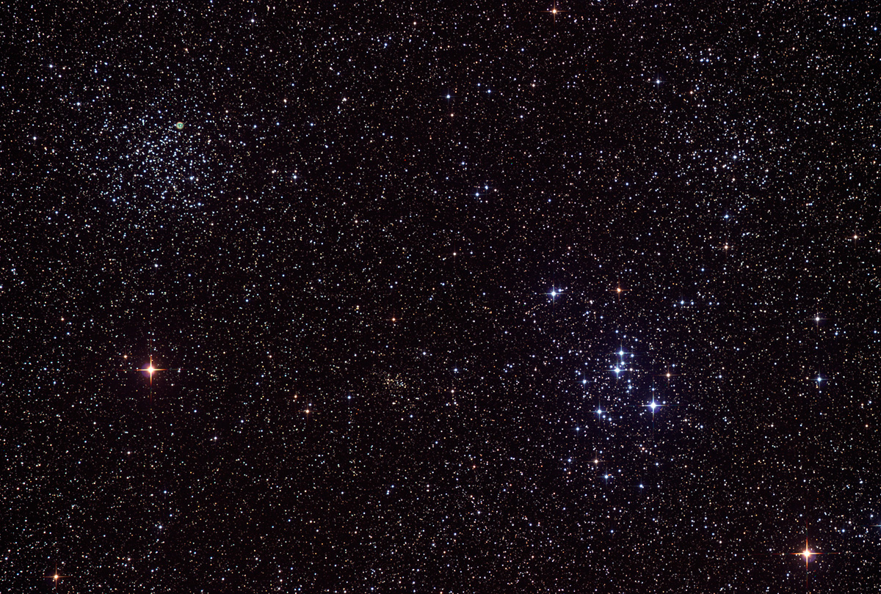

Howard
Astronomical
League
13
November 21, 2013

Slide 2
Year in Space calendars

Slide 3

Year in Space calendars

Slide 4
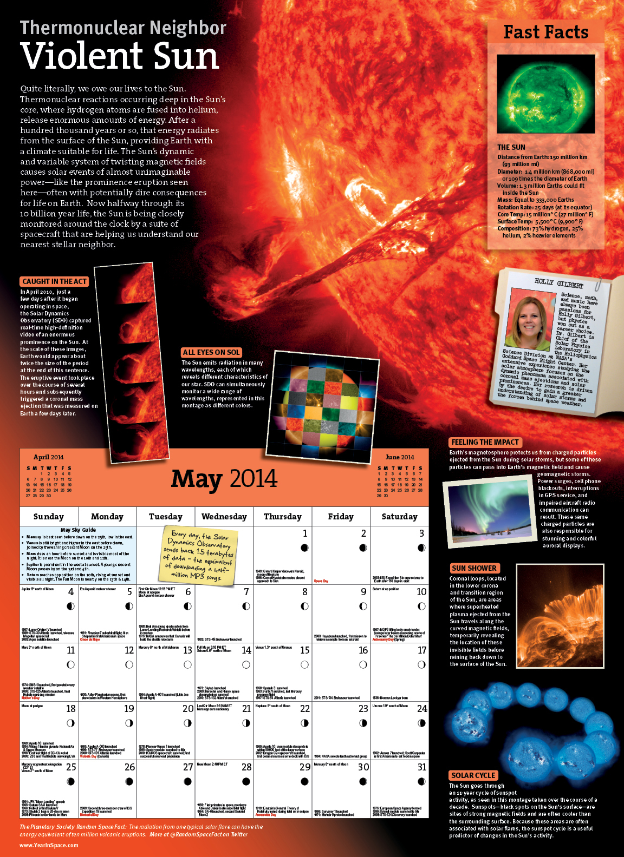

Slide 5
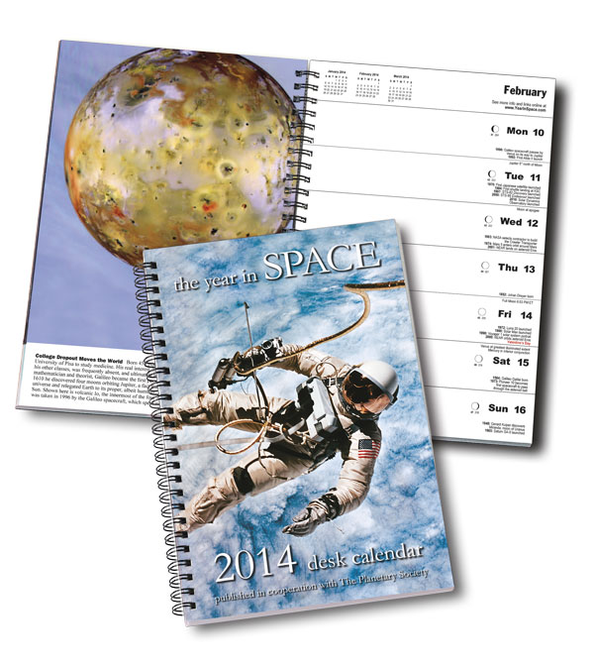
Notes:
Also mention their free weekly newsletter and facebook page

Slide 6
Year in Space calendars
Yearinspace.com

Slide 7
HAL Social Media

Slide 8
HAL Social Media
Website:
http://www.howardastro.org
Twitter:
@HalTweet
https://twitter.com/HalTweet
Facebook:
https://www.facebook.com/groups/howardastro/

Slide 9
Astronomical League Observing Club Awards

Slide 10
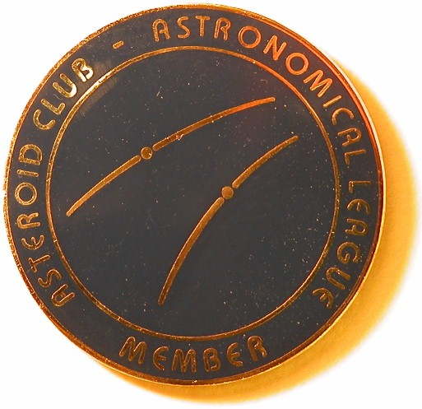
Steve Jaworiwsky
Asteroid Club

Slide 11
Upcoming club activities

Slide 12
HAL Elections!
HAL elects a new Board of Directors every January.
Contact HALElection@howardastro.org if you’re interested in running.

Slide 13
Star Parties and public outreach!
Members only and Public star parties:
Wait until next year!
RNC Family Night
December 6th, 6-8 PM

Slide 14
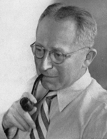
Van Maanen’s Star

Slide 15
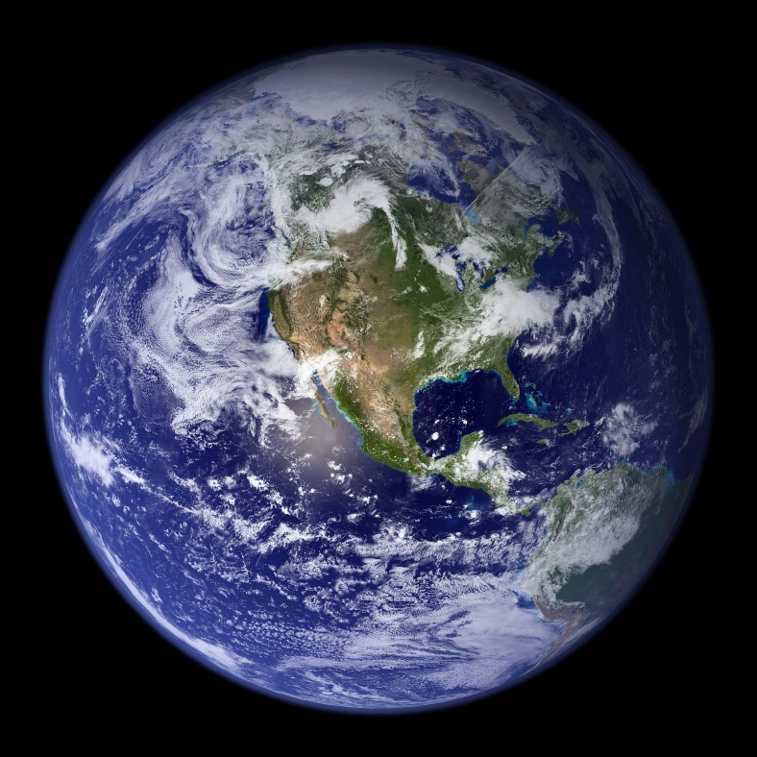
Van Maanen’s Star
Earth

Slide 16
Pegasus
Great Square
.
Epsilon Piscium
.
Delta Piscium
Pisces

Slide 17
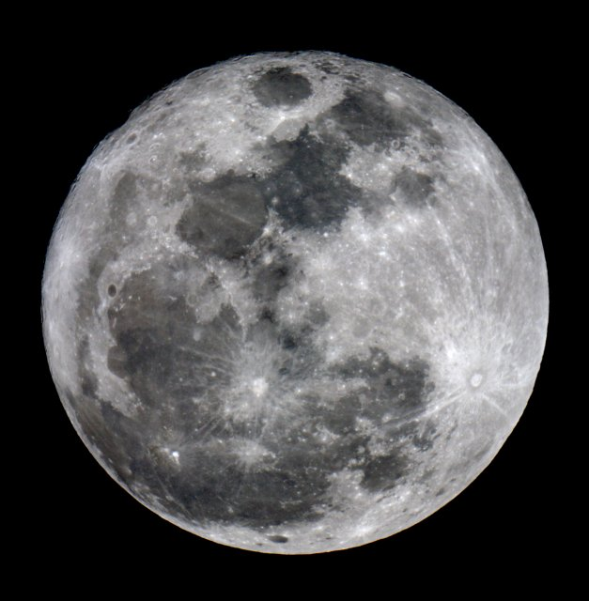
Delta Piscium
Approximate size of Full Moon
HD 4628
( Mirror Imaged )

Slide 18
( Mirror Imaged )
10th Magnitude Star
.
Van Maanen’s Star
(Magnitude 12.374)
HD 4628
.
11th Magnitude Star
9th Magnitude Star

Slide 19
Member’s astrophotos and sketches

Slide 20
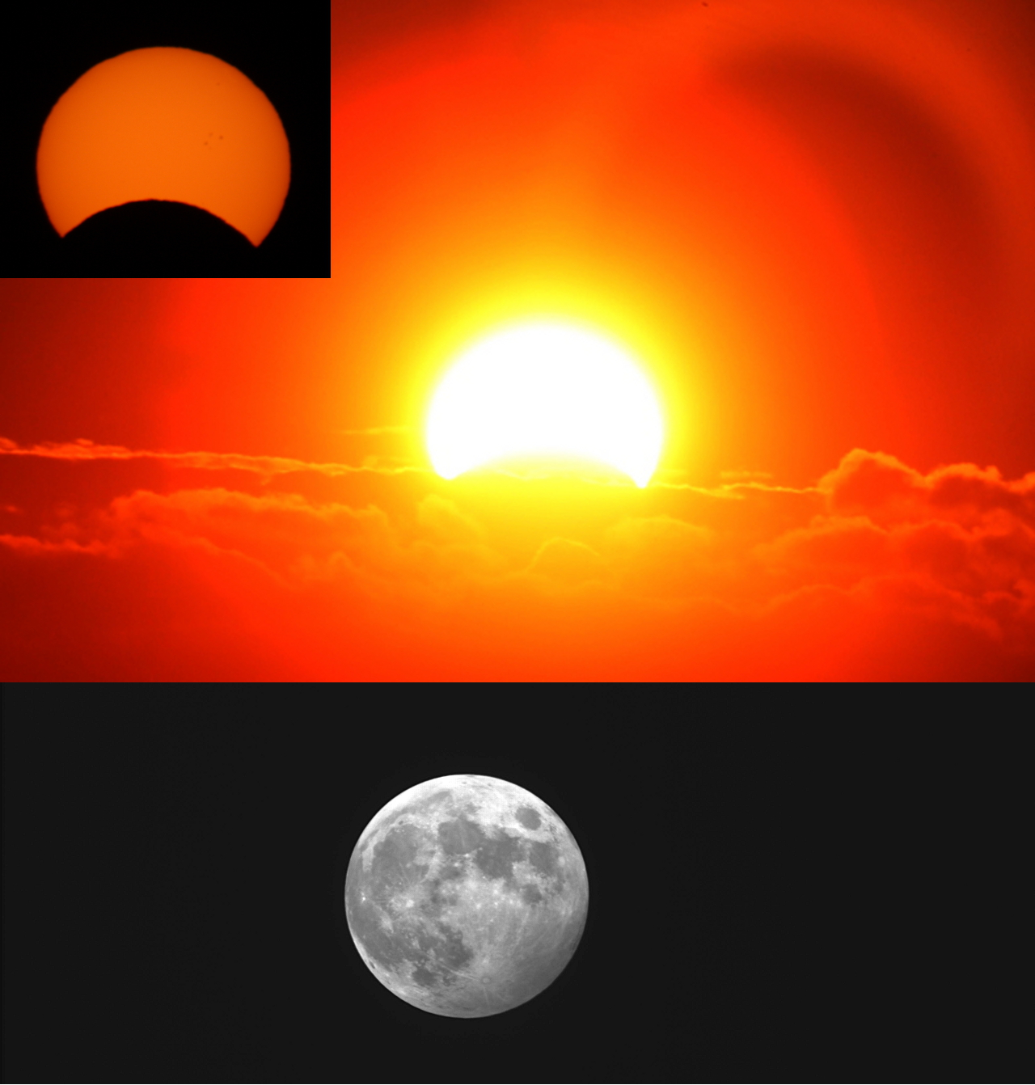
Gene Handler

Slide 21
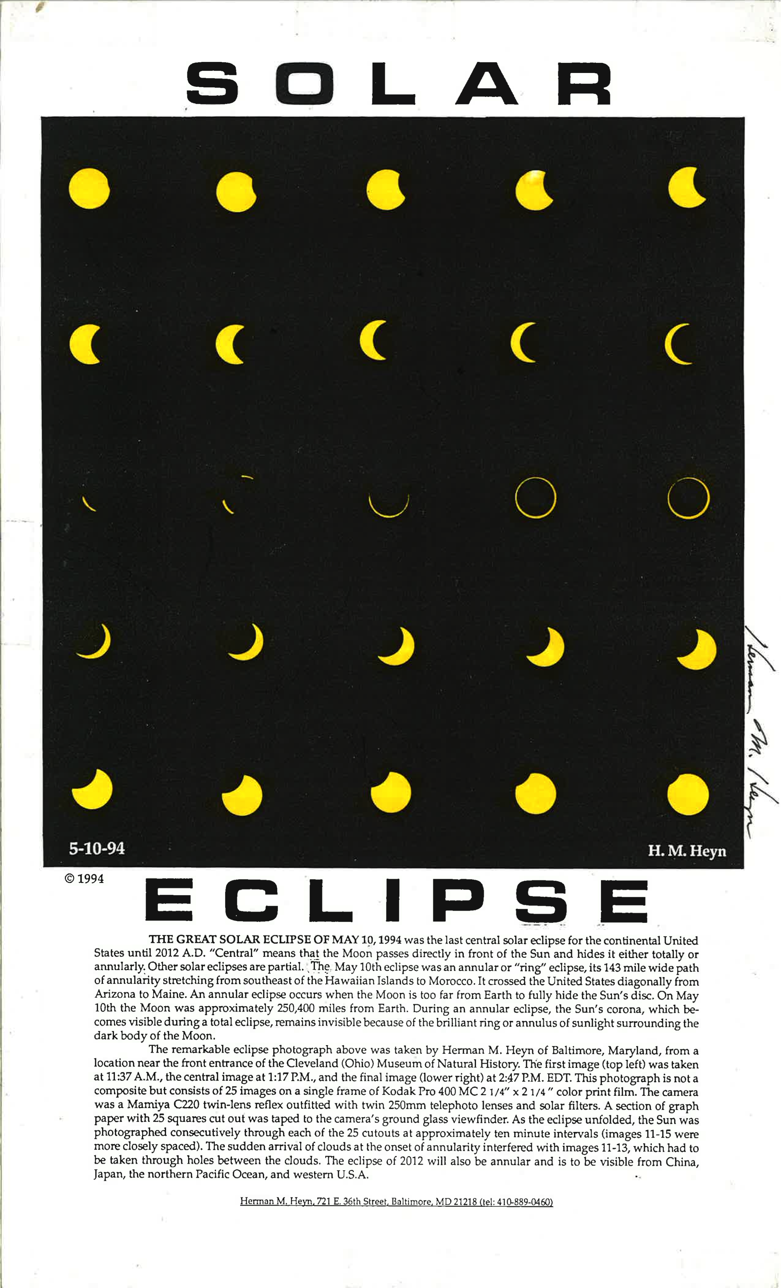
Herman Heyn

Slide 22
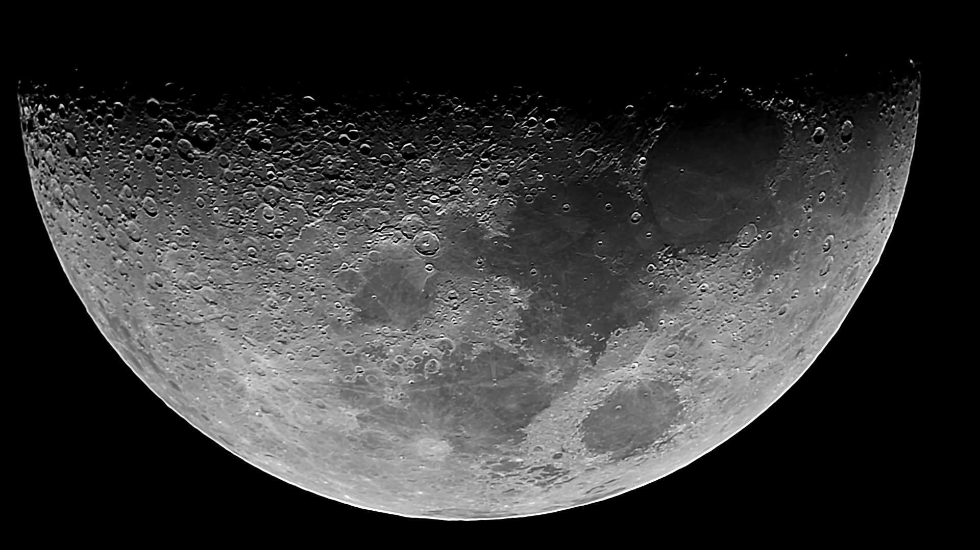
Victor Sanchez

Slide 23
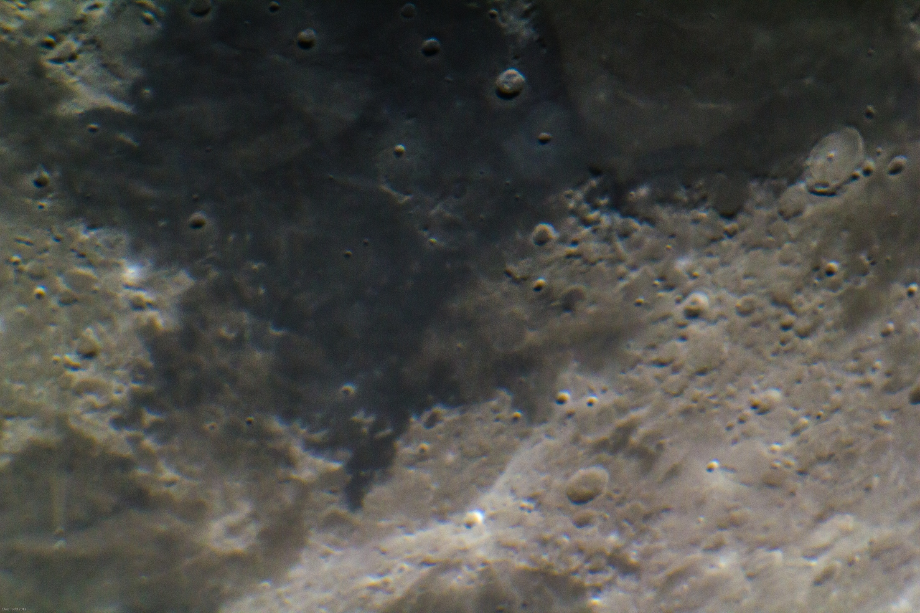
Chris Todd

Slide 24
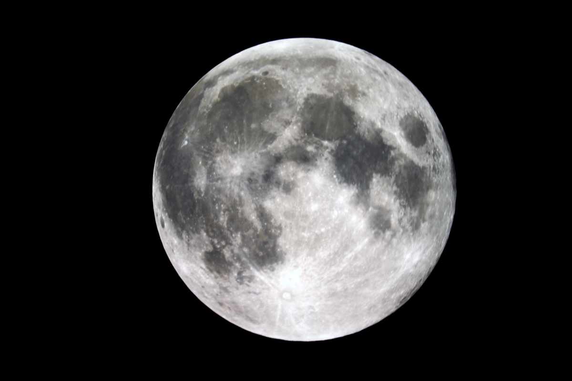
Mike Krauss

Slide 25
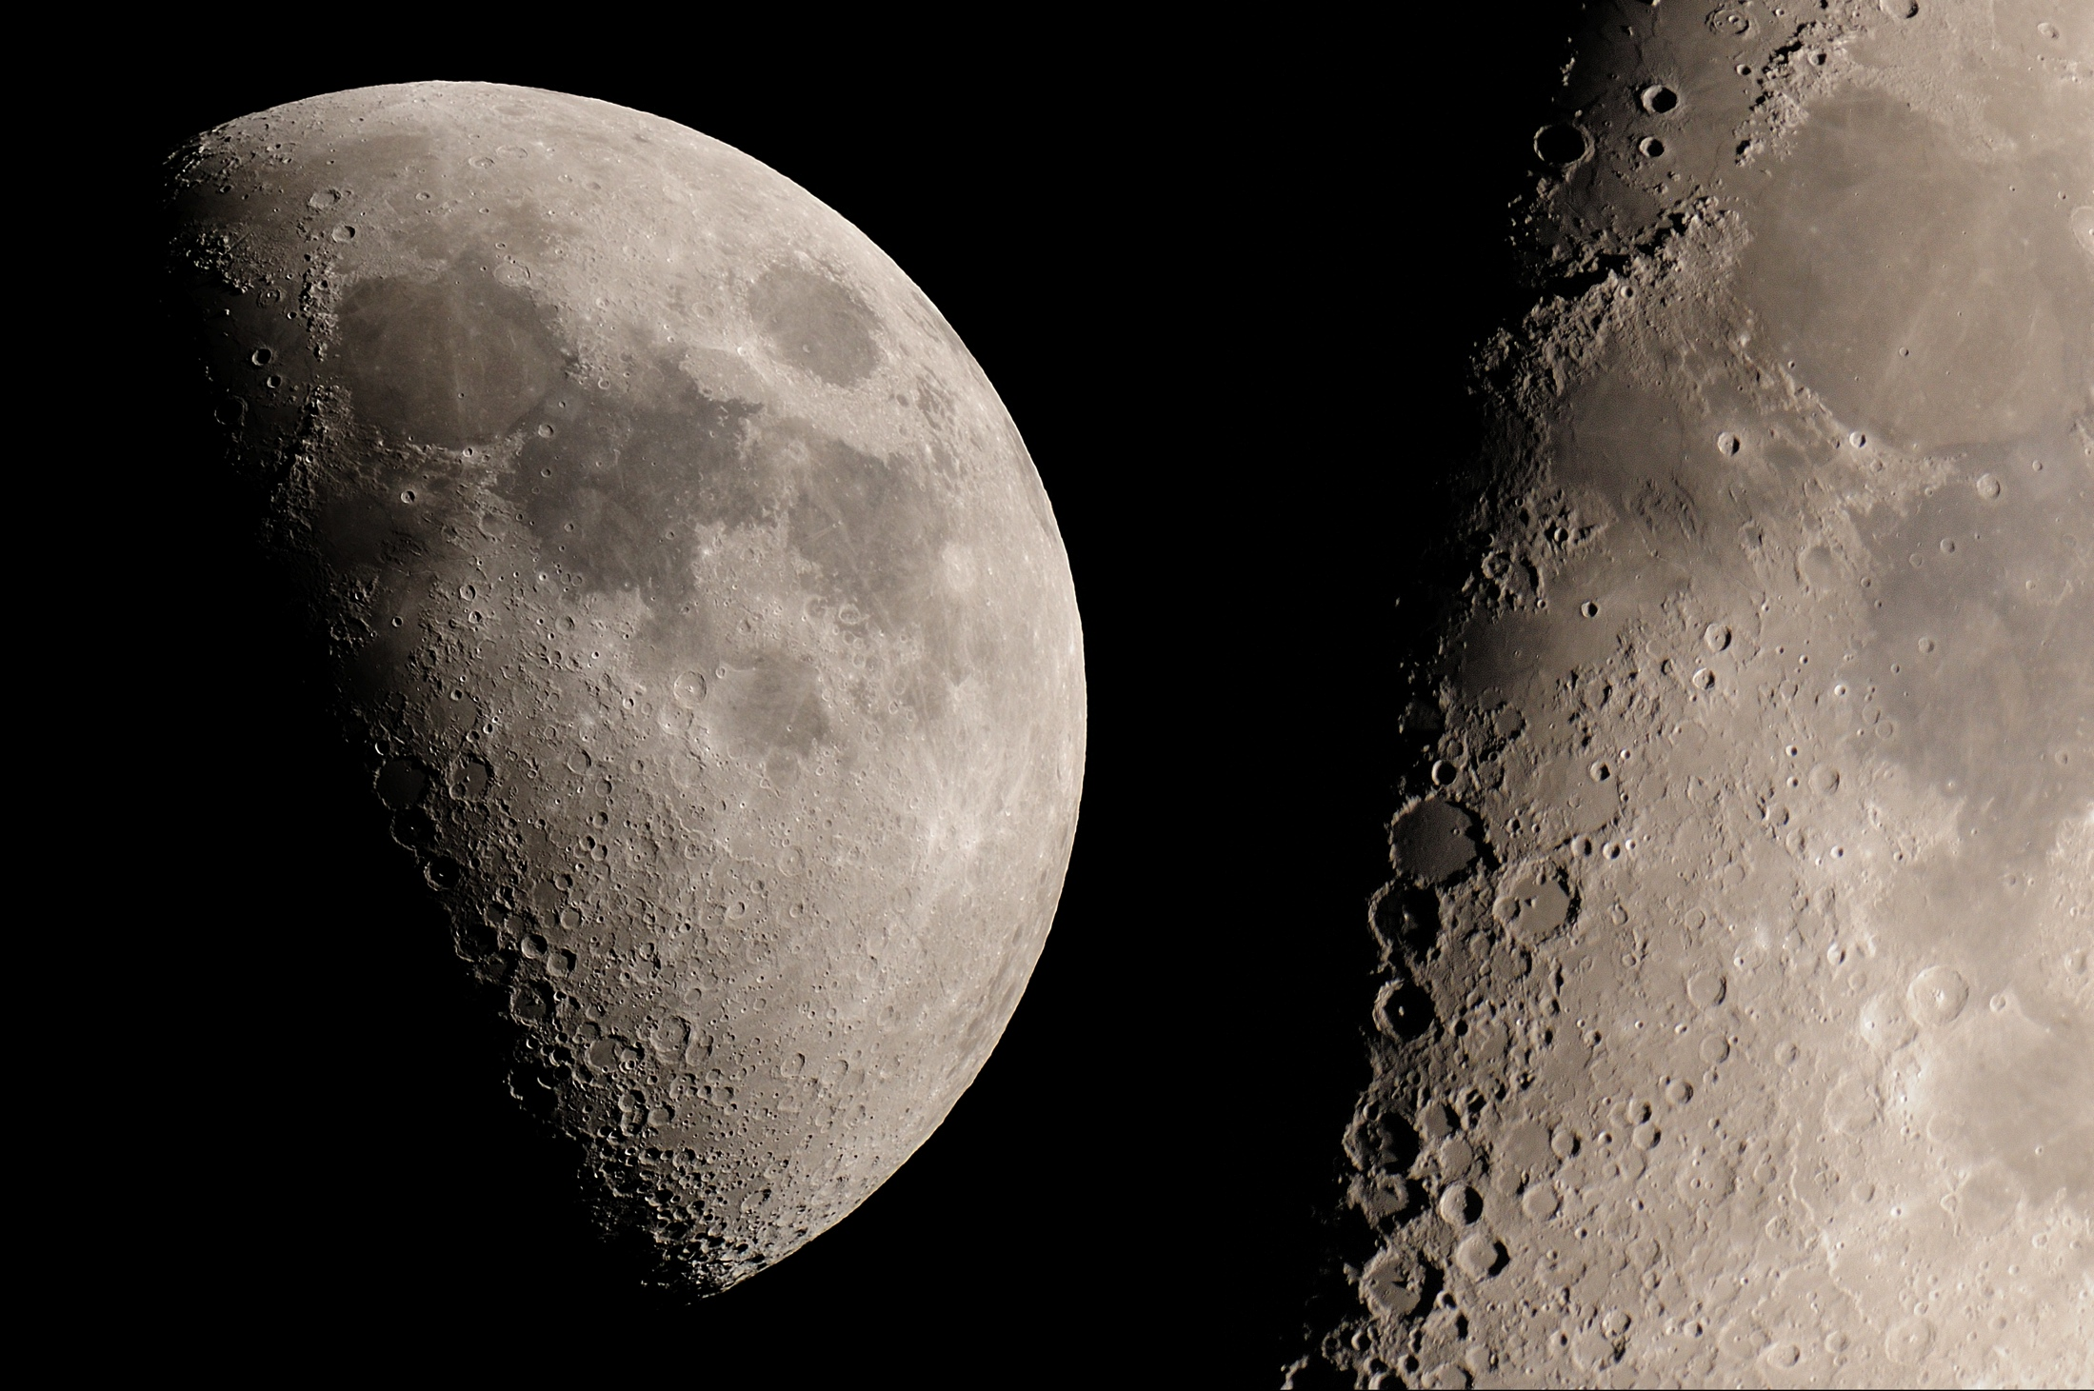
Richard Orr

Slide 26
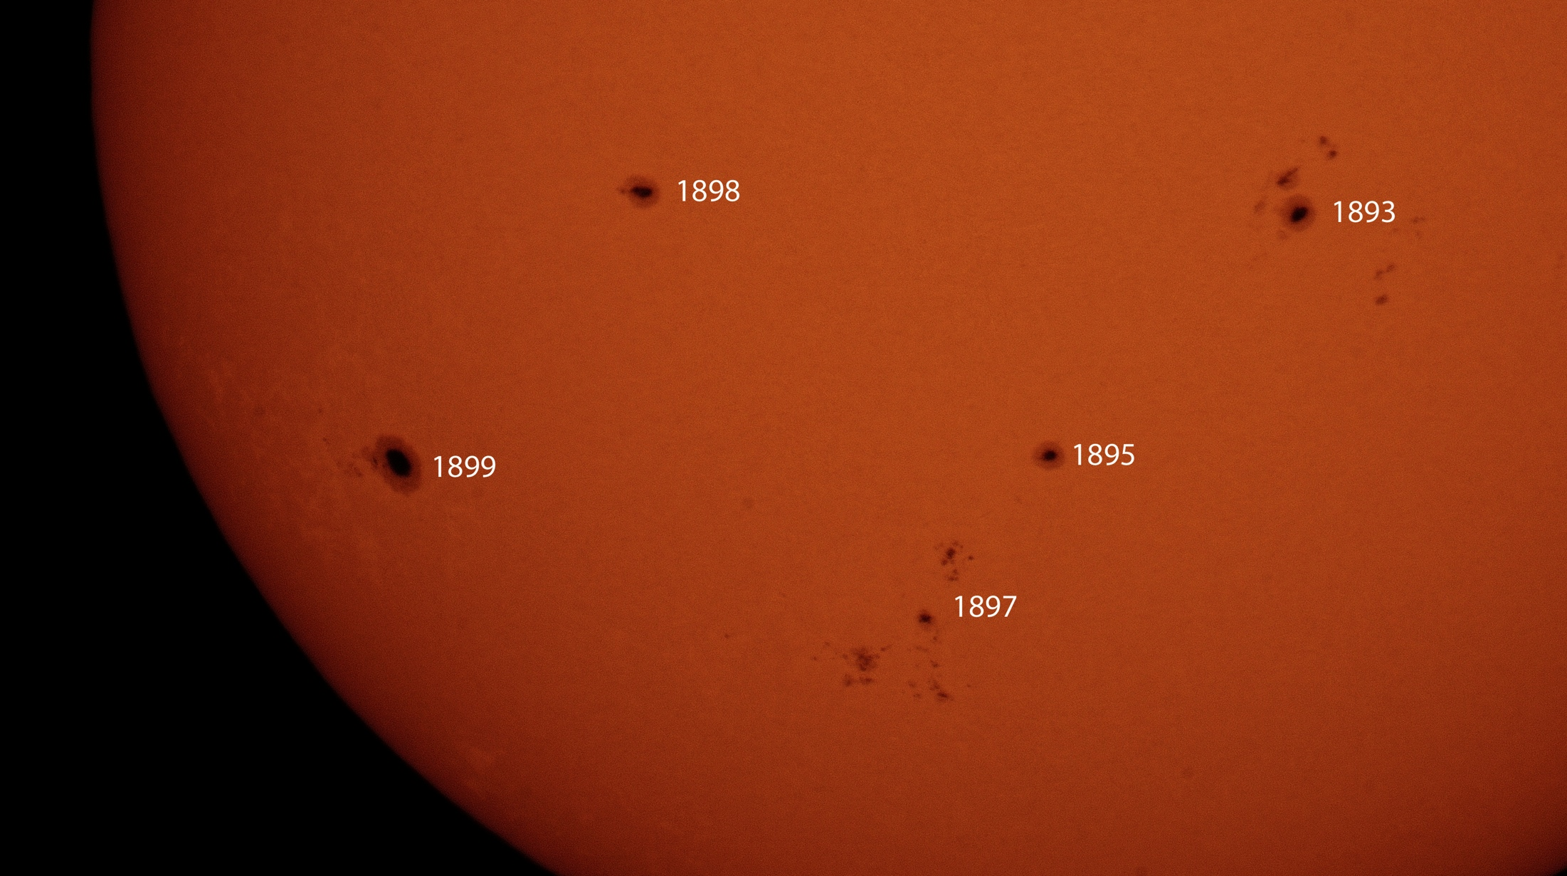
Richard Orr

Slide 27
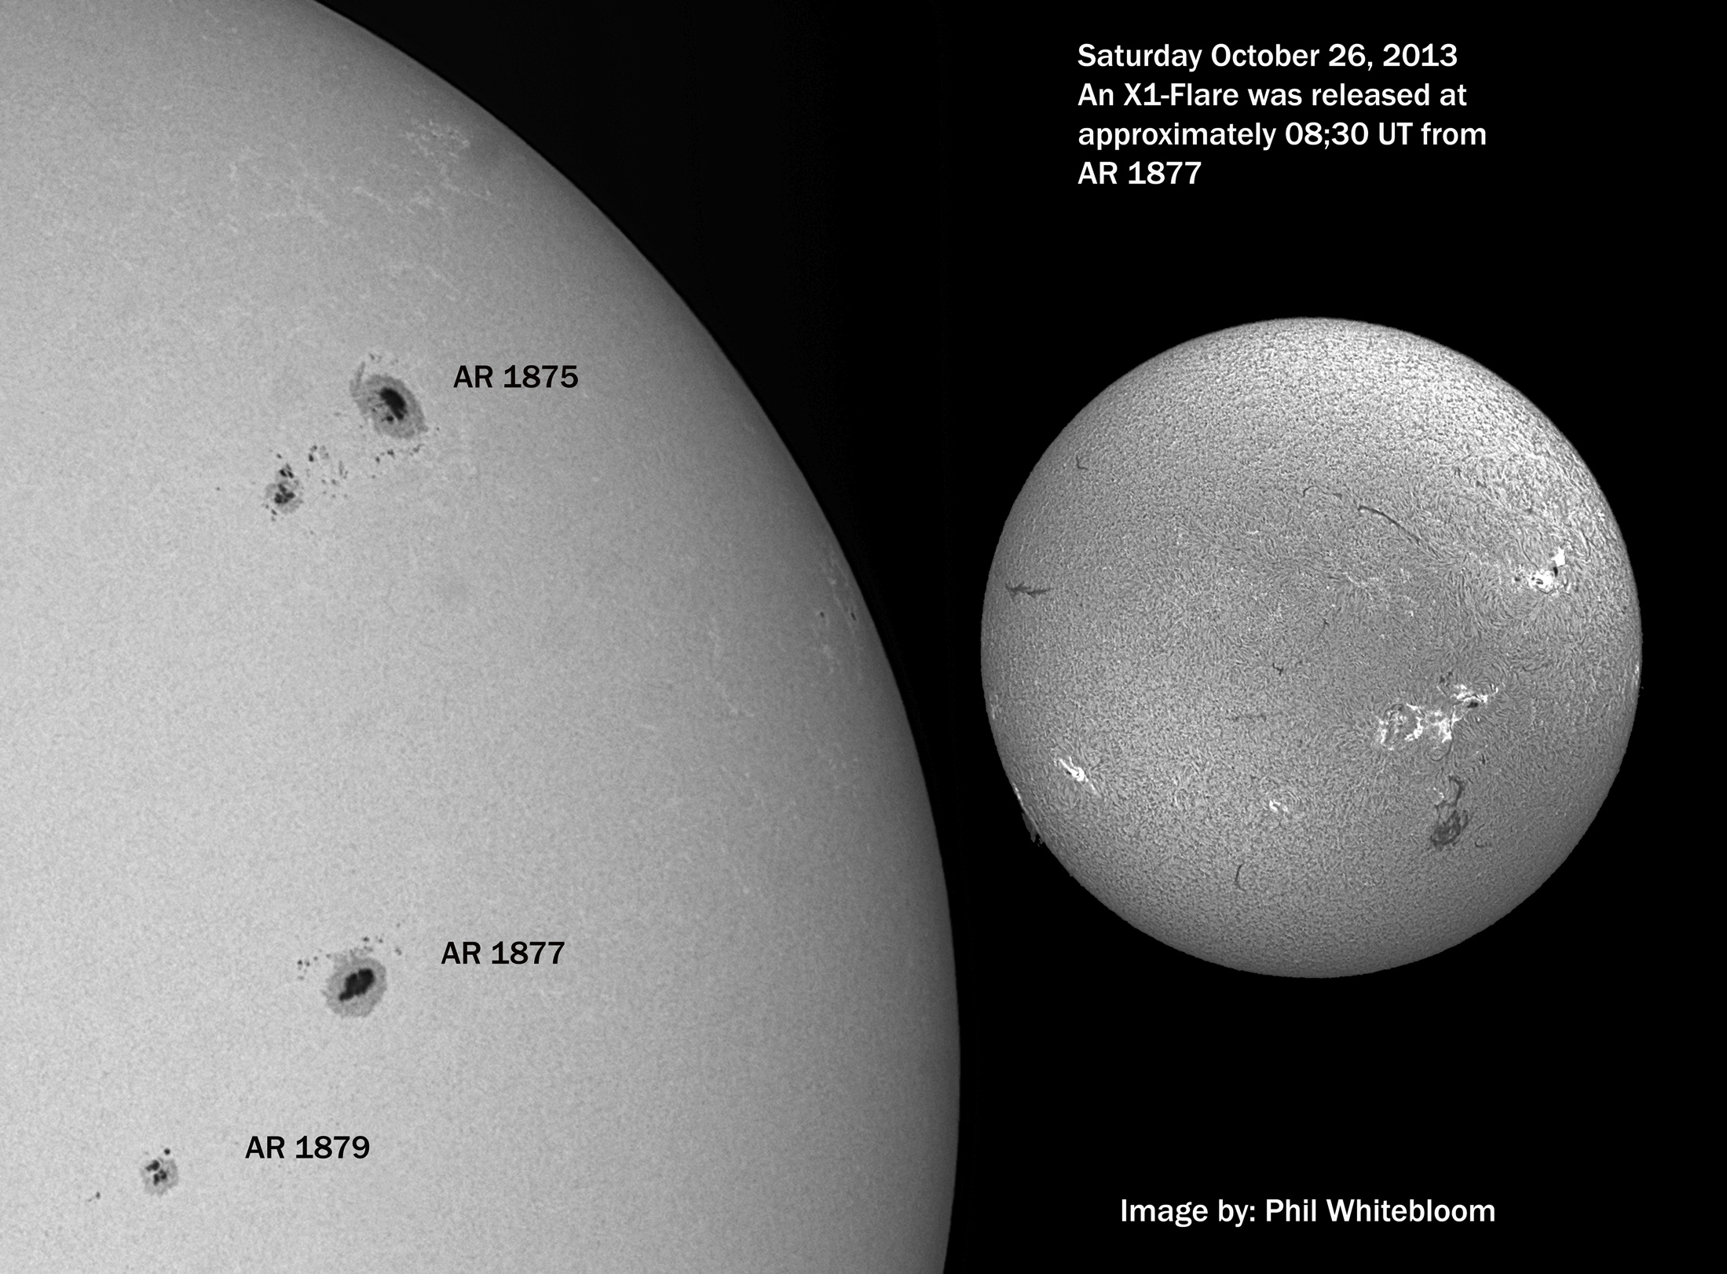
Phil Whitebloom

Slide 28
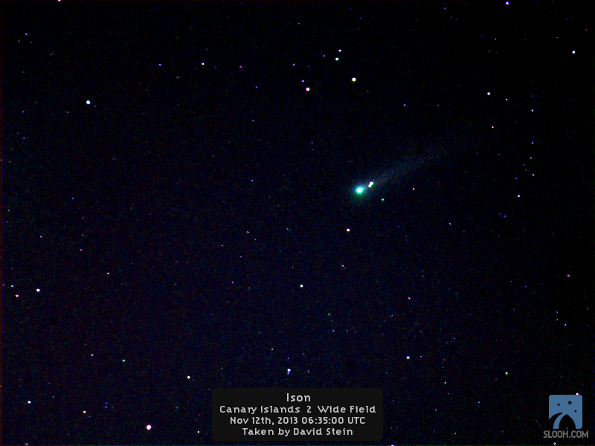
David Stein

Slide 29
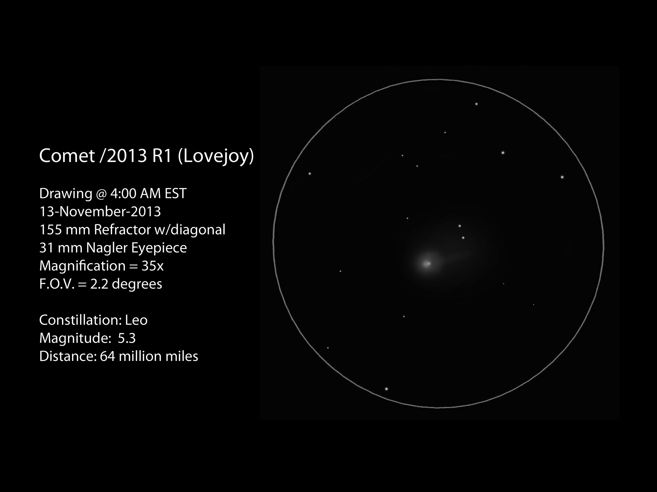
Richard Orr

Slide 30
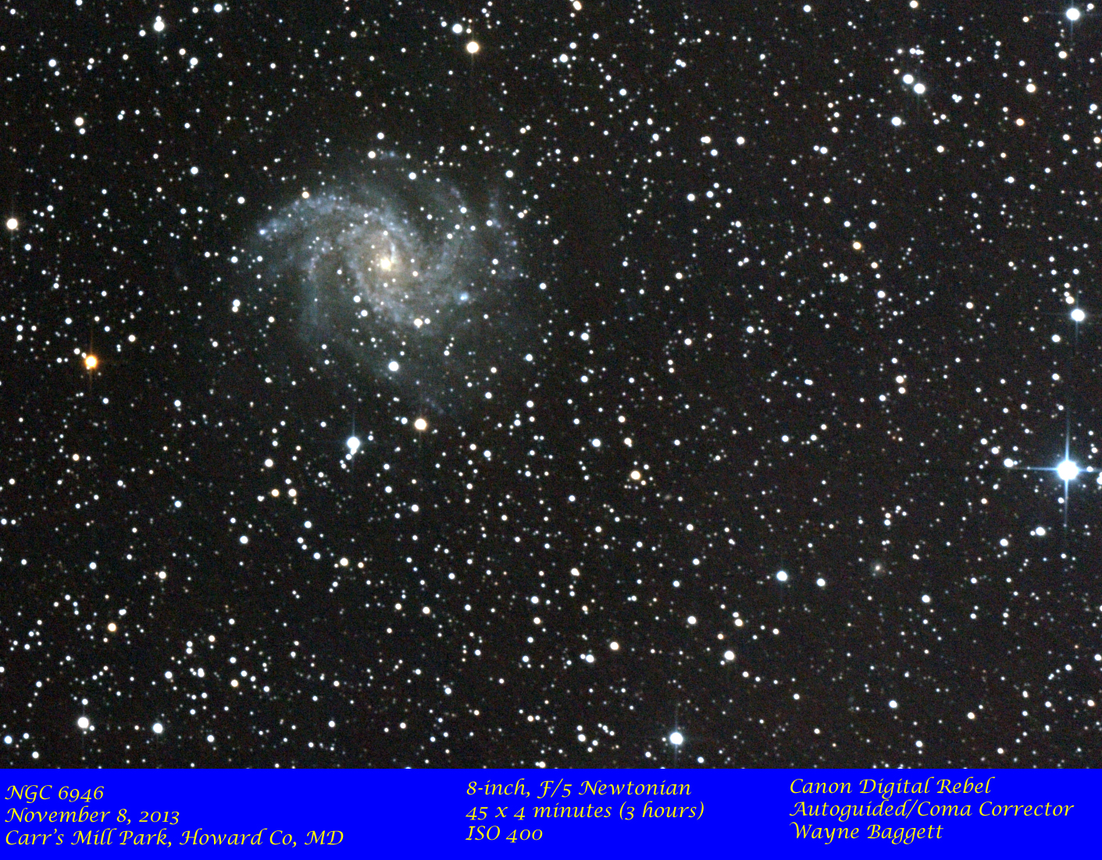
Richard Orr

Slide 31
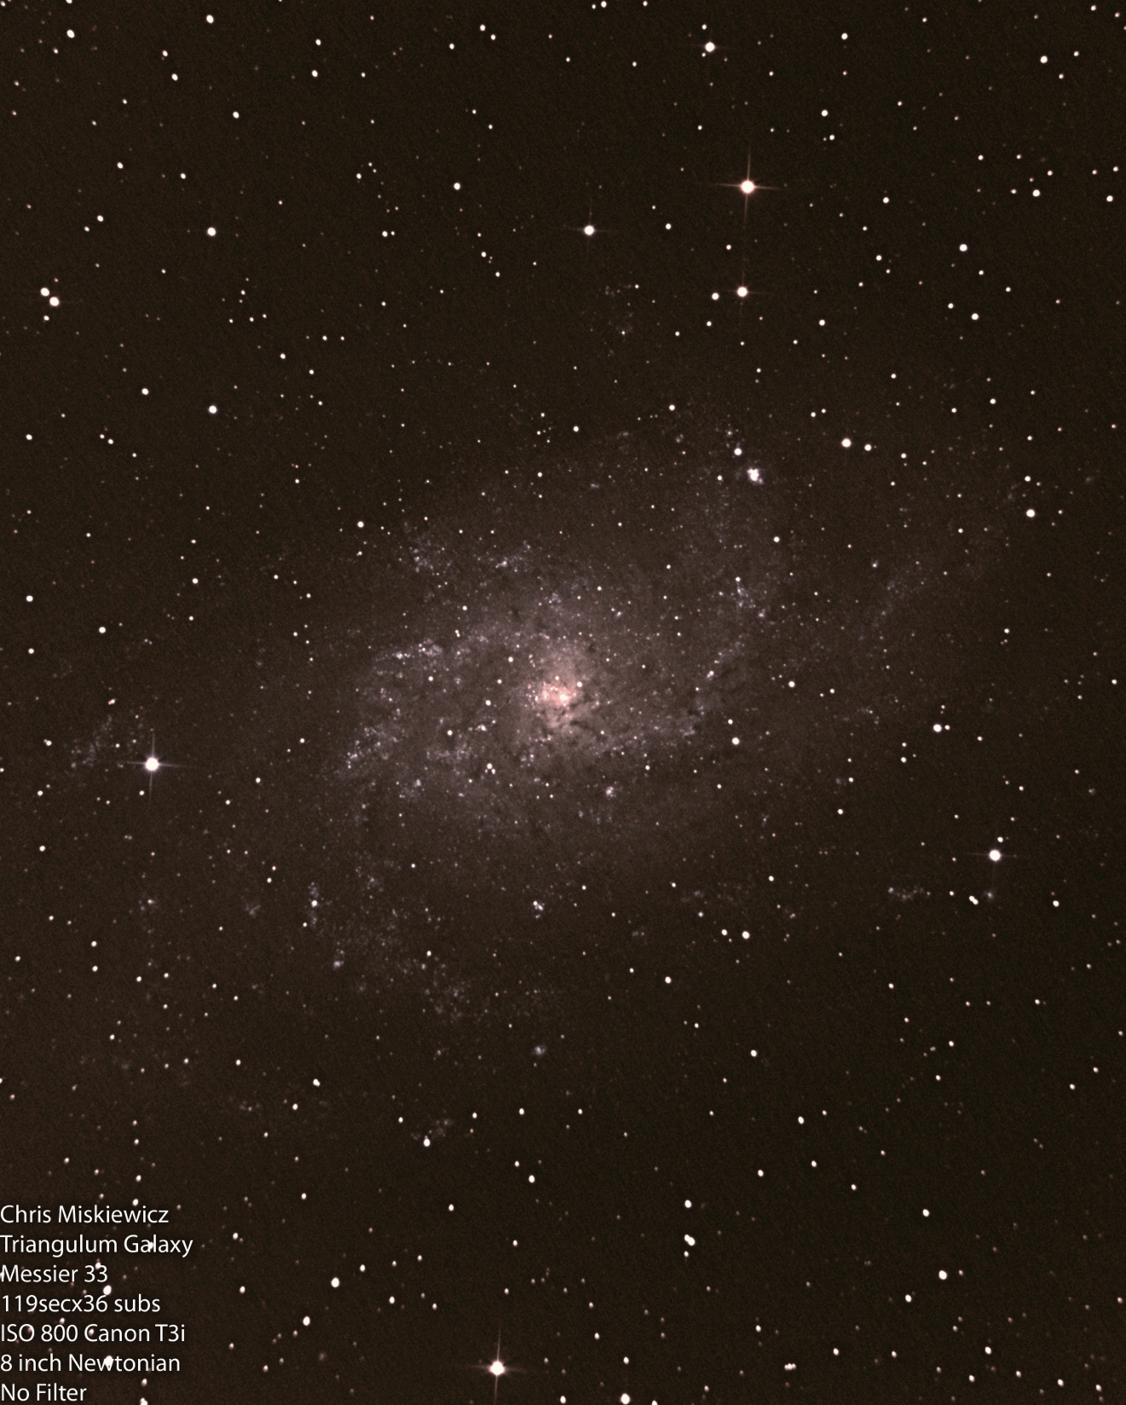
Chris Miskiewicz

Slide 32
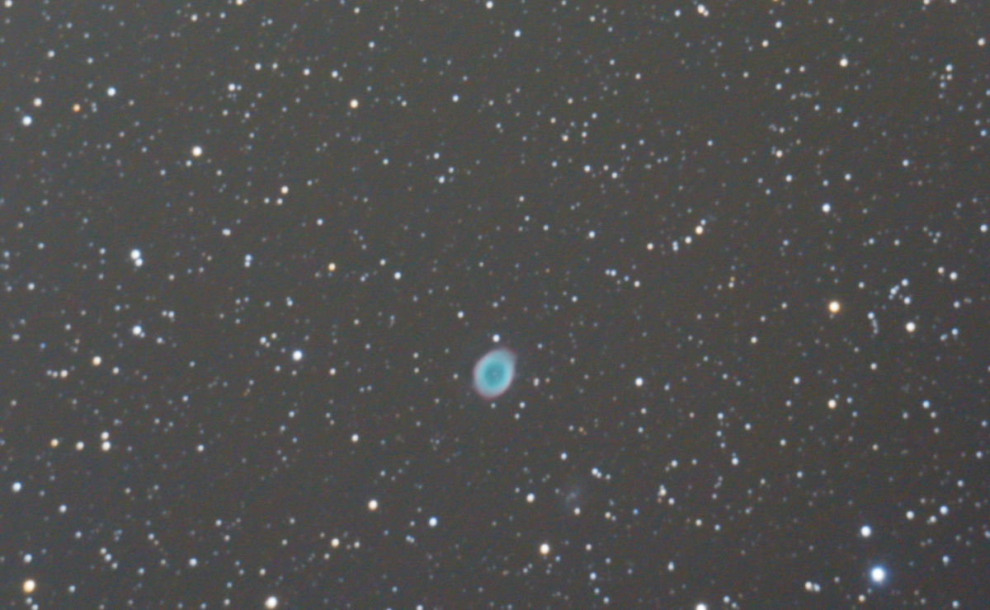
Mike Krauss

Slide 33
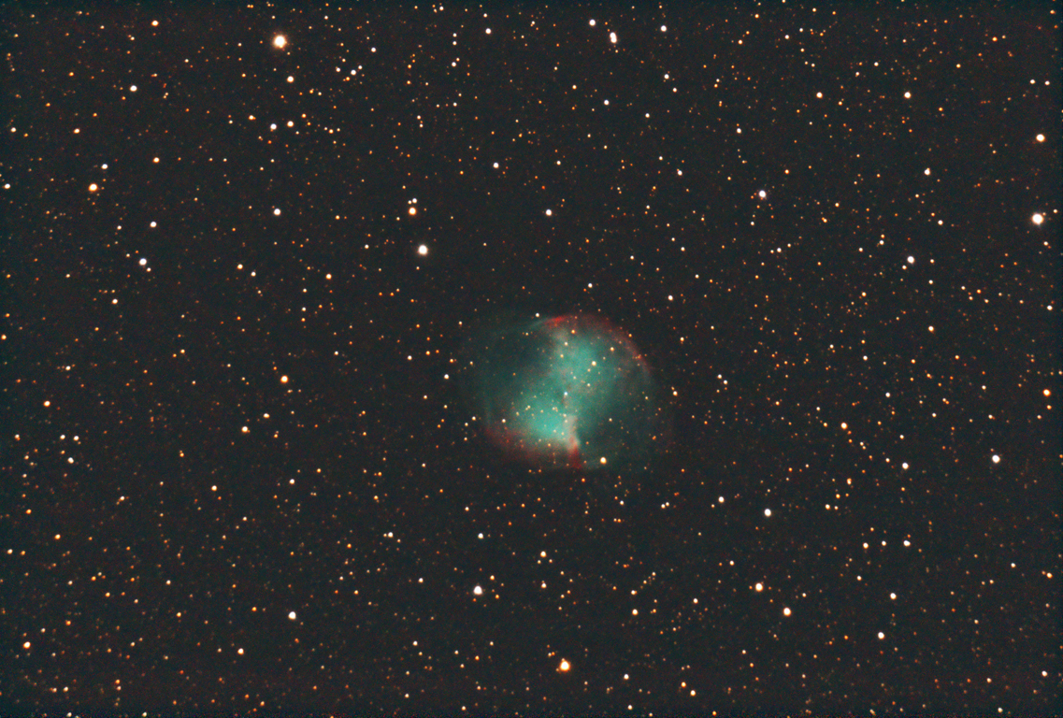
Mike Krauss

Slide 34
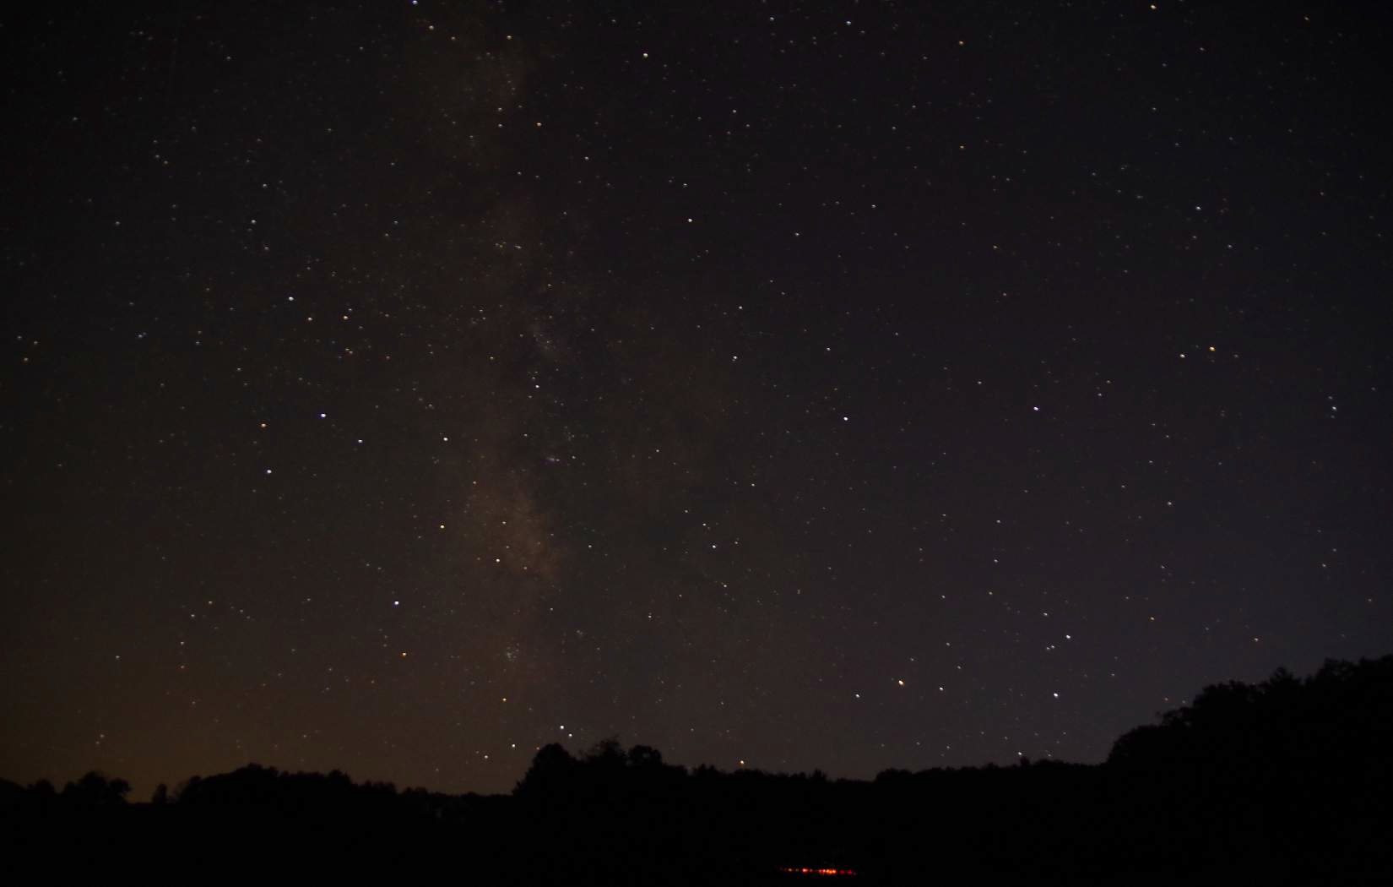
Paul Montanaro

Slide 35
Halton Arp’s
Peculiar Galaxies

Slide 36
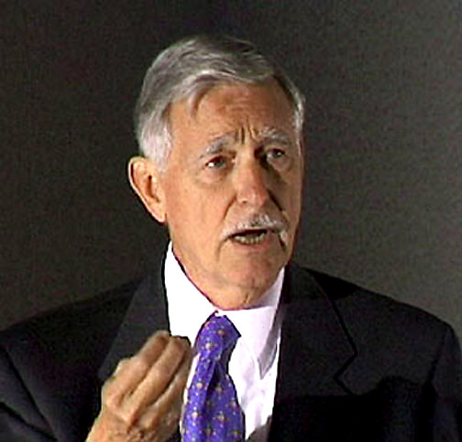
Halton Arp’s Peculiar Galaxies
Notes:
American astronomer born in 1927 (currently 86) best known for his 1966 work “Atlas of Peculiar Galaxies”. Got his BS from Harvard in 1949, and his PhD from Caltech in 1953. Spent some time at Mount Wilson and Palomar Observatory 1953-55, and after a brief stint at Indiana University, became a full staff member at the Palomar Observatory in 1957, where he worked for 29 years. Since 1983, he has been on the faculty of the Max Planck Institute for Astrophysics in Germany.
Talk about Arp’s background and history, focusing on his work at Caltech and on Mount Wilson, his work with Hubble and how he was there when Sandage was there, culminating in his interest in galaxies and galaxy formation, and his penchant for weird things.

Slide 37
Notes:
The original paper is available online:
http://ned.ipac.caltech.edu/level5/Arp/paper.pdf

Slide 38
Halton Arp’s Peculiar Galaxies
What is a peculiar galaxy?
That depends on your definition of what a “normal” galaxy is.
That requires a history lesson. “You stand on the shoulders of giants.”

Slide 39
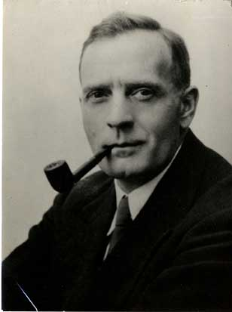
Halton Arp’s Peculiar Galaxies
Notes:
Hubble got Arp a job at Mount Wilson after his graduation at Caltech.

Slide 40
Edwin Hubble’s Normal Galaxies
Galaxies are “Island Universes” made up of stars like the Milky Way, but galaxies are not part of the Milky Way.
Hubble used the Cepheid variables discovered by Henrietta Swan-Leavitt to show that galaxies like M31 could not be a part of the Milky Way.
Notes:
Edwin Hubble published his seminal paper on galaxy morphology, "Extra-galactic nebulae". Astrophysical Journal 64: 321–369 in 1926, and his research influenced the field for nearly 40 years. His paper on Cepheid variables in M31 was published in 1929: Hubble, E. P. (1929). "A spiral nebula as a stellar system, Messier 31". Astrophysical Journal 69: 103–158.

Slide 41
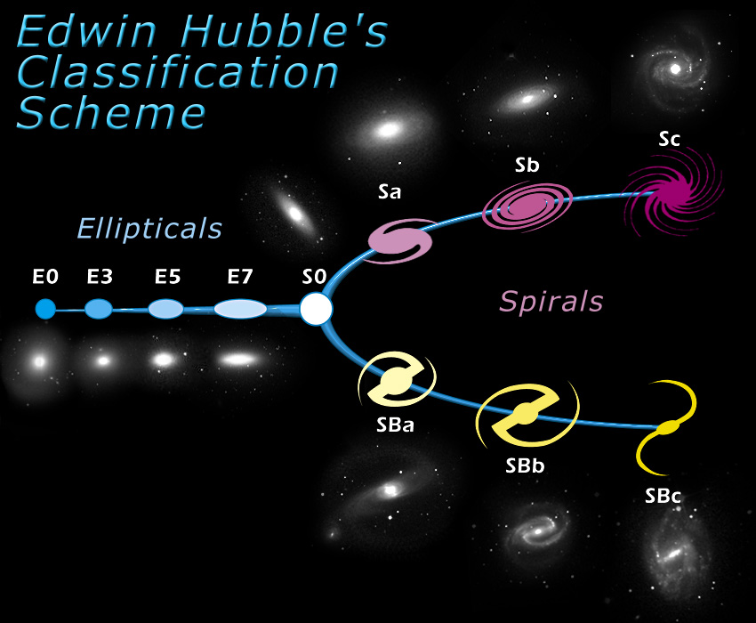
Image credit: http://skyserver.sdss.org/dr1/en/proj/advanced/galaxies/tuningfork.asp

Slide 42
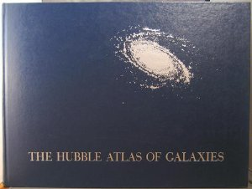
The Hubble Atlas of Galaxies
Notes:
Pictures of normal galaxies, mention The Hubble Atlas of Galaxies, by Allan Sandage, and perhaps hold up the copy Joel will bring, which is from the HAL library. This may take more than one slide.

Slide 43
Hubble’s tuning fork
Example galaxies from Hubble’s Atlas
Notes:
Pictures of normal galaxies, mention The Hubble Atlas of Galaxies, by Allan Sandage, and perhaps hold up the copy Joel will bring, which is from the HAL library. This may take more than one slide.

Slide 44
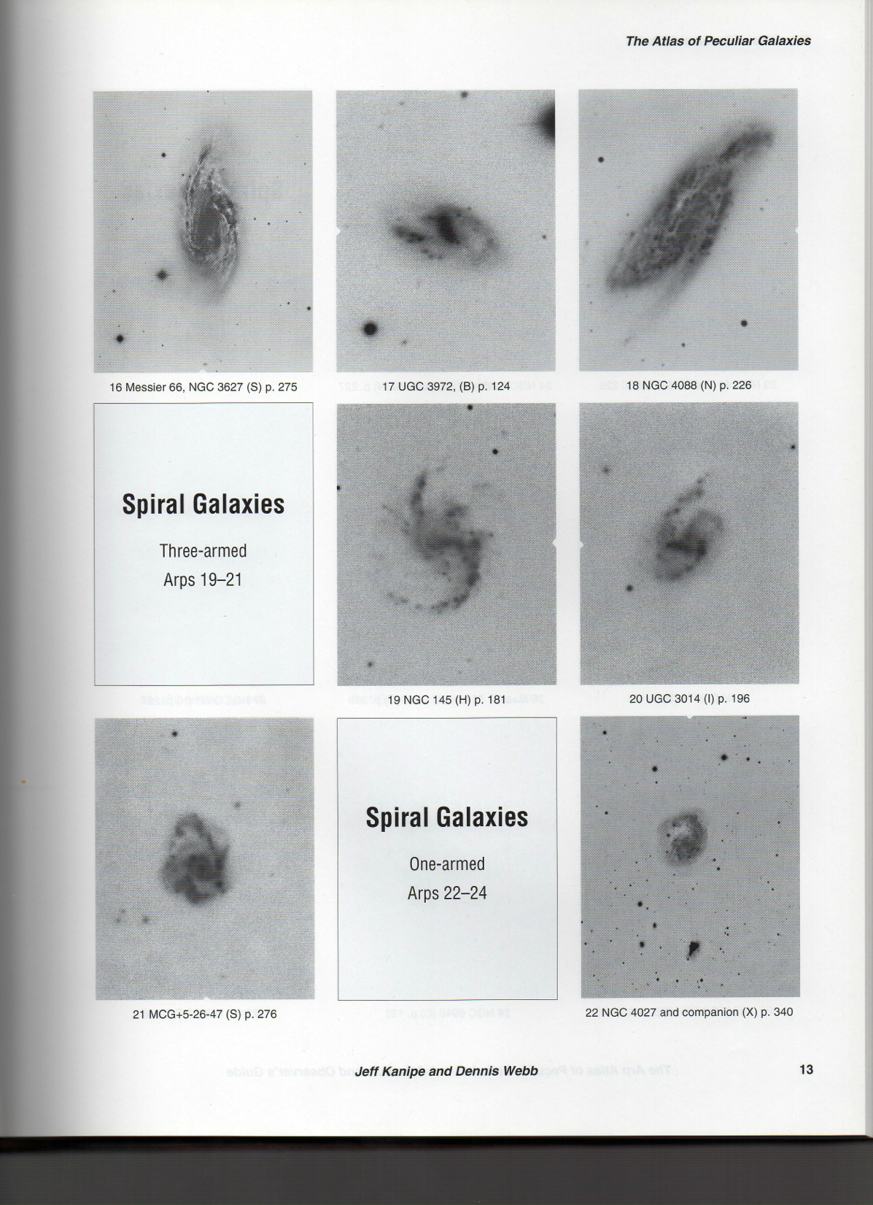
Notes:
Pictures from Arp’s Atlas Peculiar Galaxies. Use several slides to demonstrate just how freaking weird these were.

Slide 45
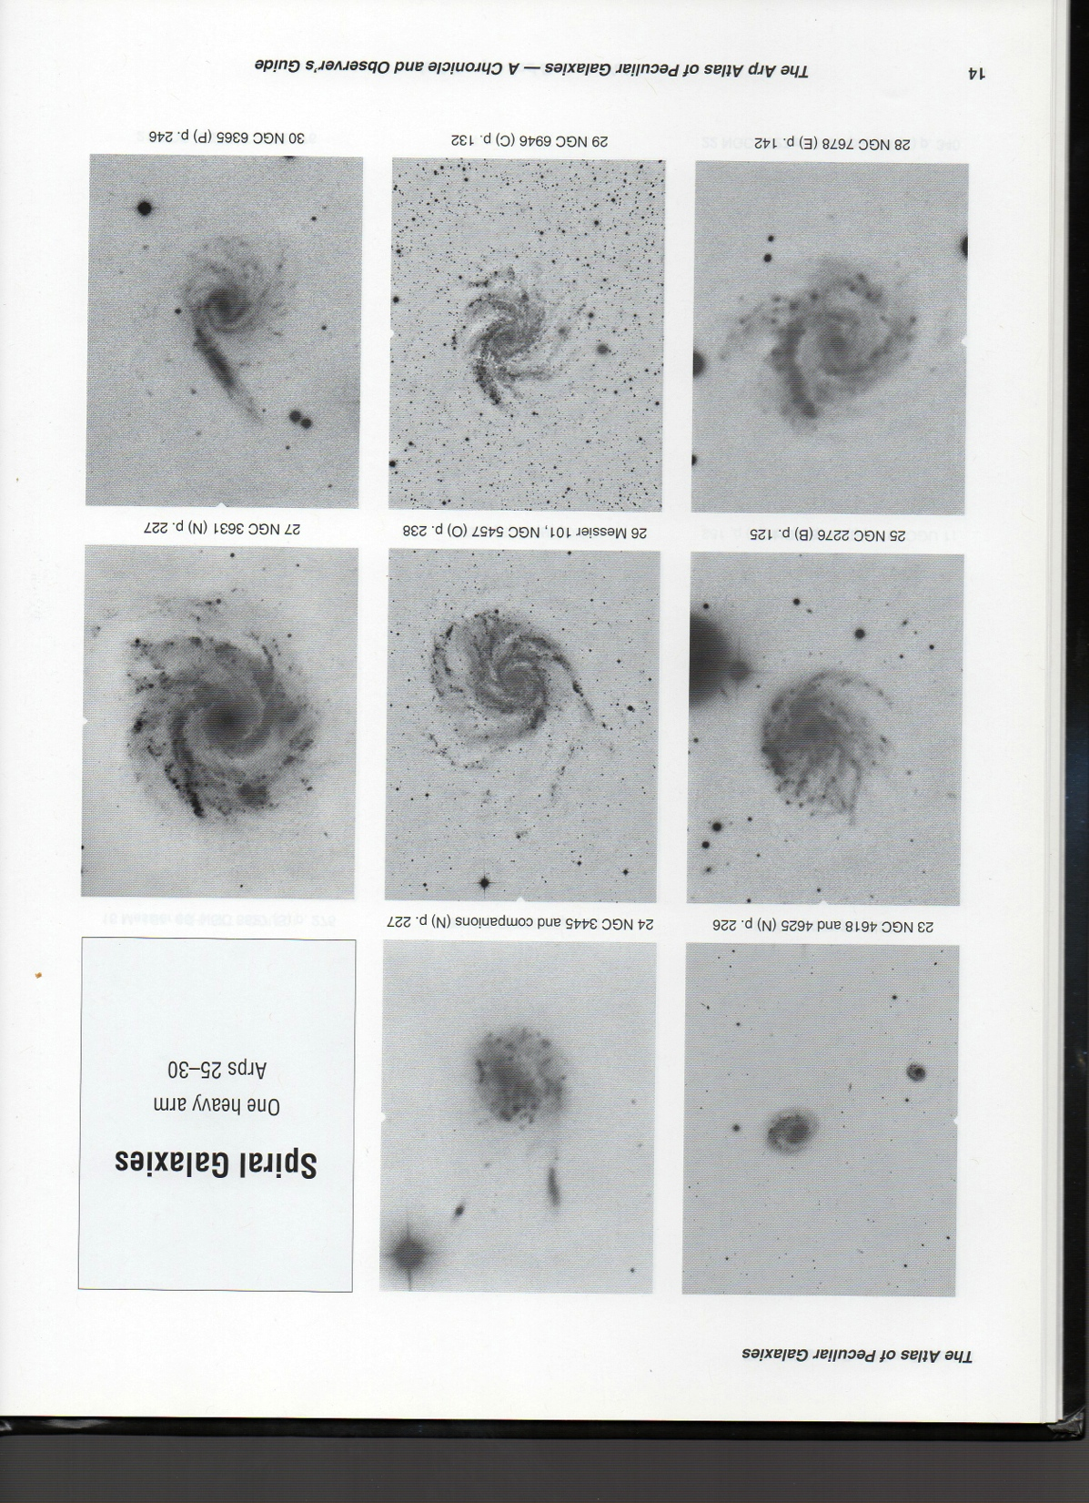
Notes:
Pictures from Arp’s Atlas Peculiar Galaxies. Use several slides to demonstrate just how freaking weird these were.

Slide 46
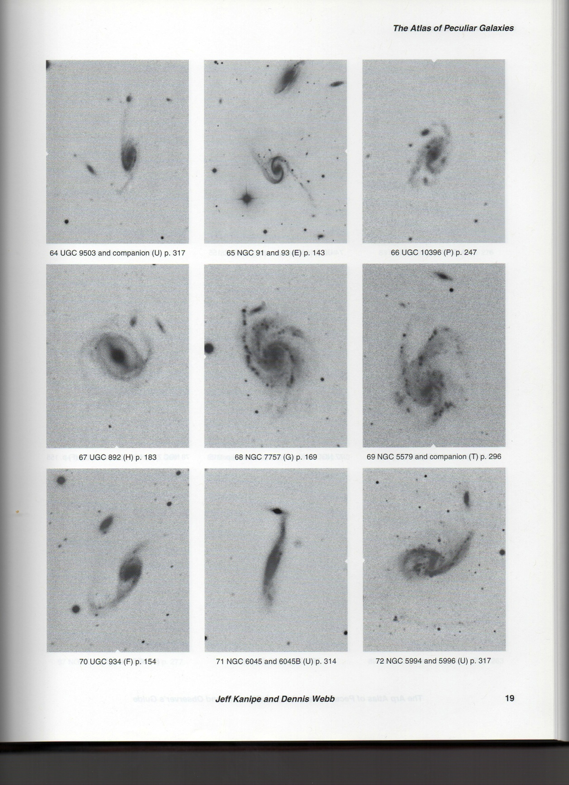
Notes:
Pictures from Arp’s Atlas Peculiar Galaxies. Use several slides to demonstrate just how freaking weird these were.

Slide 47
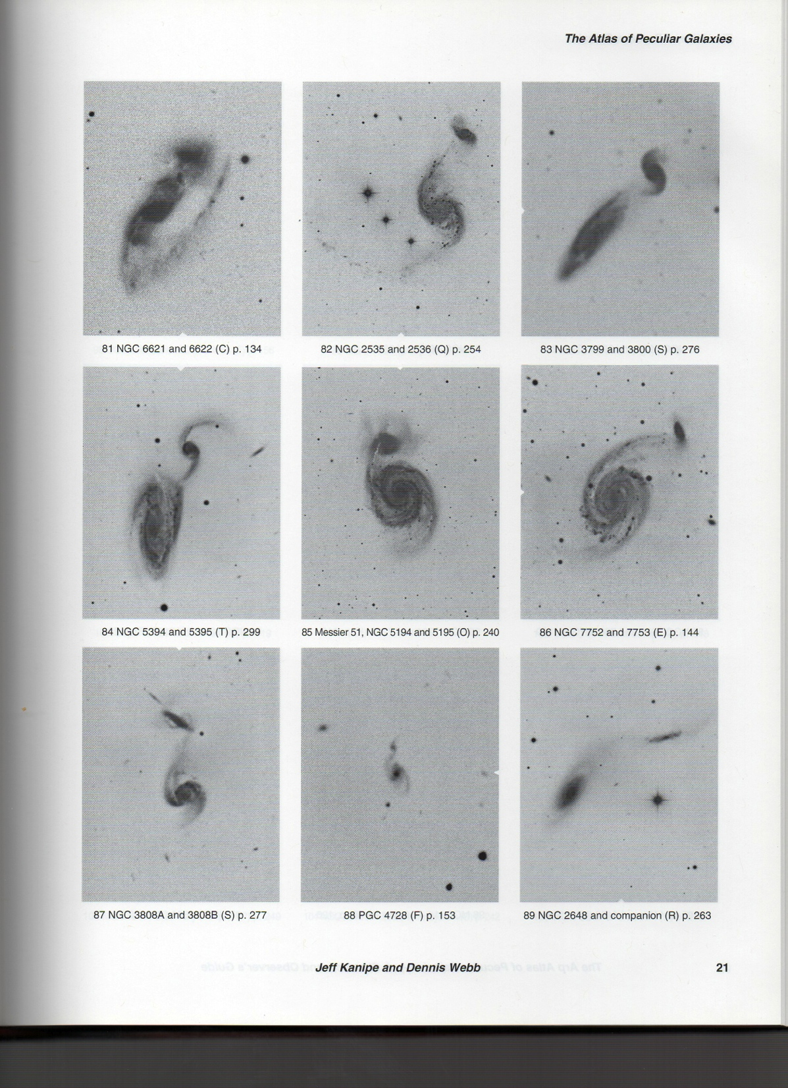
Notes:
Pictures from Arp’s Atlas Peculiar Galaxies. Use several slides to demonstrate just how freaking weird these were.

Slide 48
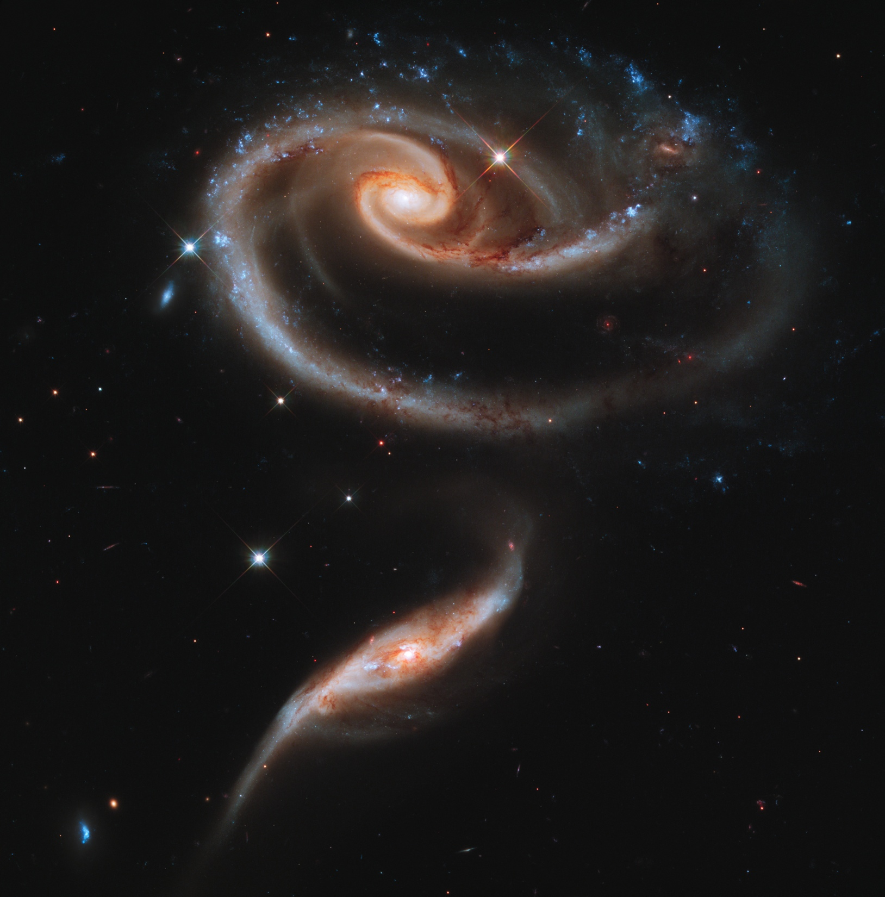
Notes:
Arp 273

Slide 49
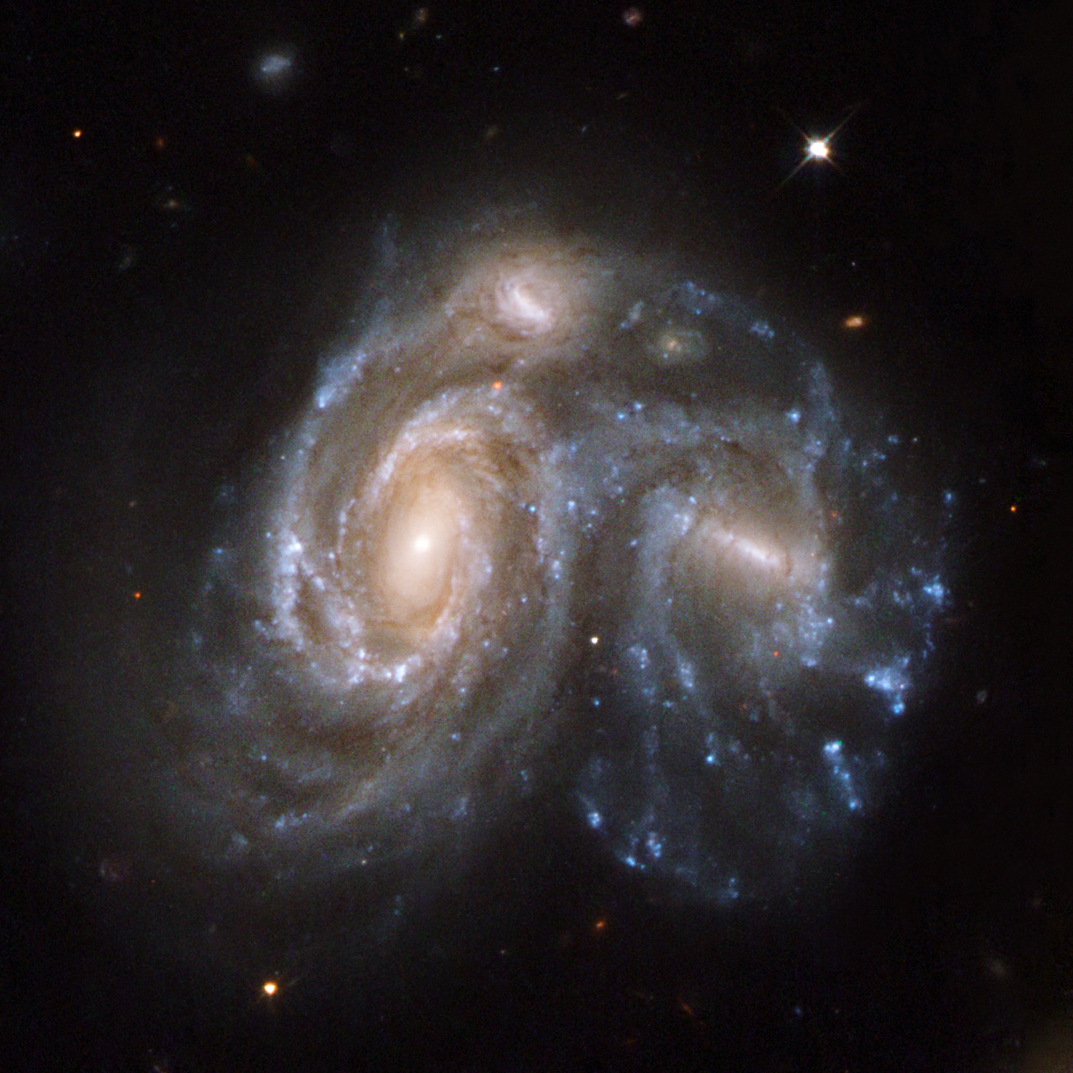
Notes:
Arp 272

Slide 50
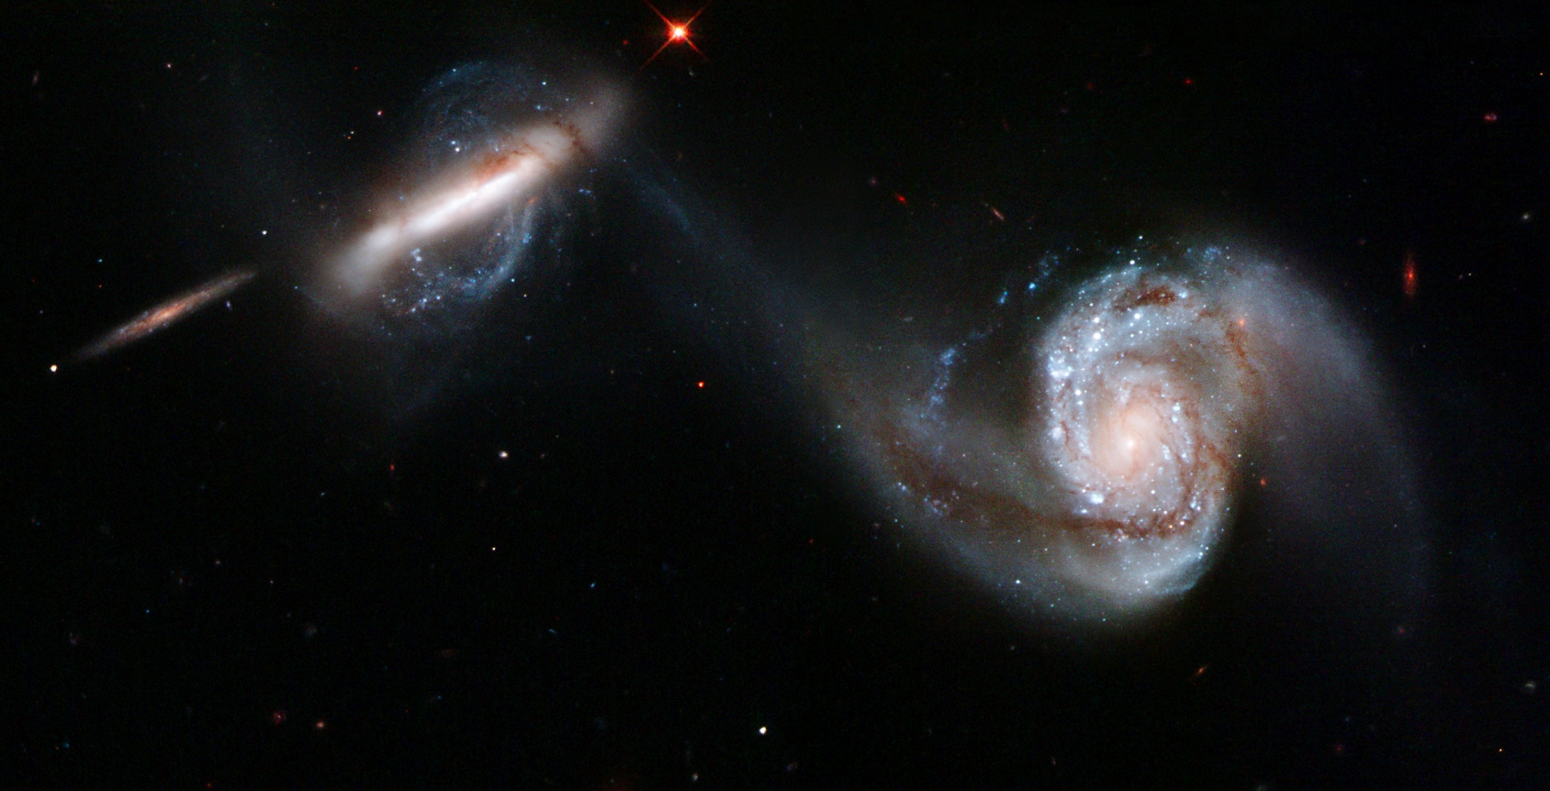
Notes:
Arp 87

Slide 51
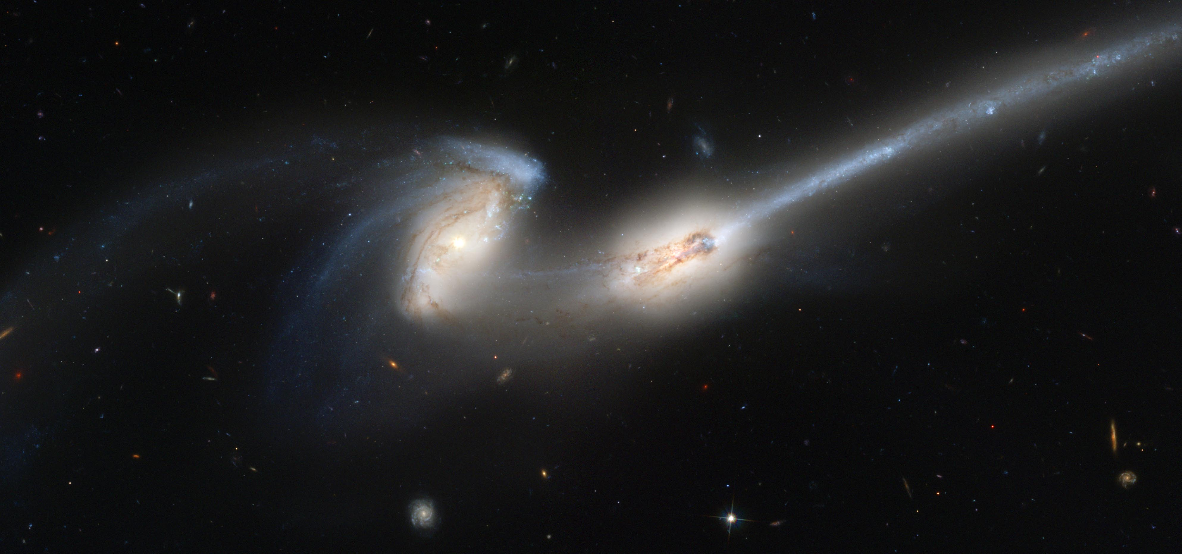
Notes:
Arp 242, aka the mice

Slide 52
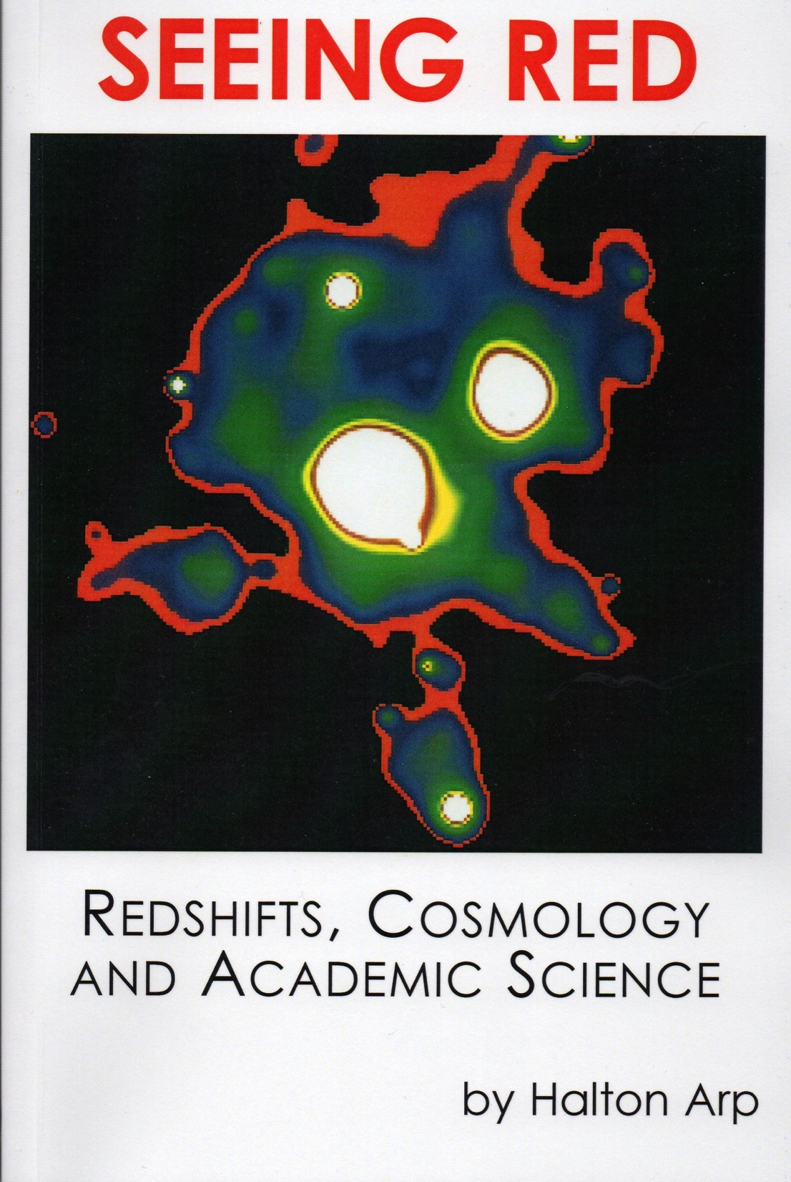
Arp’s Intrinsic Red Shift
Are red shifts solely due to recessional velocities?

Slide 53
Arp’s Peculiar Galaxies
Observing club
Four variations:
Visual or Imaging
Northern or Southern
Observe or photograph 100 Arp objects
Most objects 12th to 18th mag, but there are >100 brighter than mag 13.5
Notes:
For visual observation, you will need a light bucket – minimum aperture of 12 inches is recommended.

Slide 54
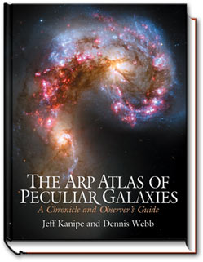
Notes:
Discuss this awesome book from Jeff Kanipe and Dennis Webb

Slide 55
Arp Atlas, Webb & Kanipe
Introduction – 8pp
Improved version of the original Atlas of Peculiar Galaxies – 44pp
Biographical section – 43pp
Observing guide – 250+ pages:
Amateur drawings or photographs, descriptions, charts, tables, diagrams
Notes:
The book contains a short intro (8pp), followed by an improved reproduction of the original Atlas (44pp), then a biographical section that details his work and tribulations (43pp), but most of the book about 250 pages) is an observing guide for the amateur, which in many ways is the coolest part of the book.

Slide 56
Remote Imaging:
Paying for high quality astrophotography data

Slide 57
Or, how to get a great astrophotograph without:
Freezing your butt off or losing sleep
Spending $20,000 on equipment
Hauling your gear thousands of miles to dark sites
Dealing with the frustration of equipment not working

Slide 58
Providers:
Slooh.com
iTelescope.net
(formerly Global Rent A Scope)
Notes:
Ask whether anyone knows of any others.

Slide 59
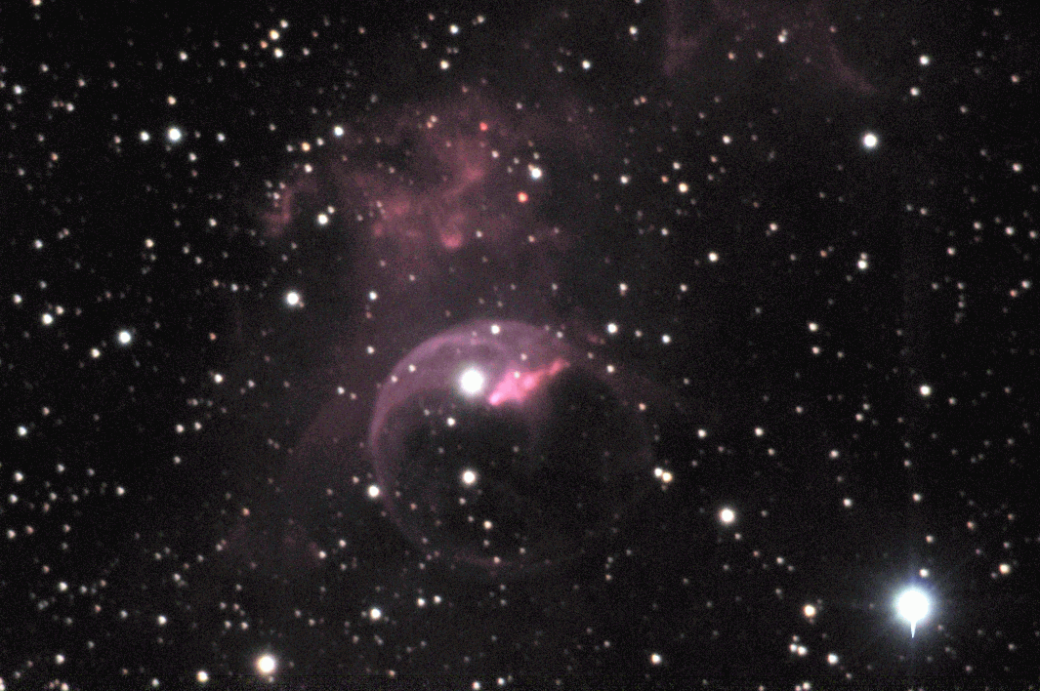
David Stein, via slooh.com
Notes:
LRGB, 11 x 5 min, converted to TIFF with FITS Liberator and stacked in Deep Sky Stacker
TELESCOPE= 'Slooh.com T2HM C14 @ f/11' /telescope used to acquire this image
INSTRUMENT= 'Slooh.com T2HM SBIG ST10XME @ 0.351arcsec/pix@Bin1x1' /instrument or
camera used
OBSERVER= 'Slooh.com Teide 2 Observatory T2HM'
NOTES = 'Data generated by slooh.com''s Teide Online Observatory.'

Slide 60
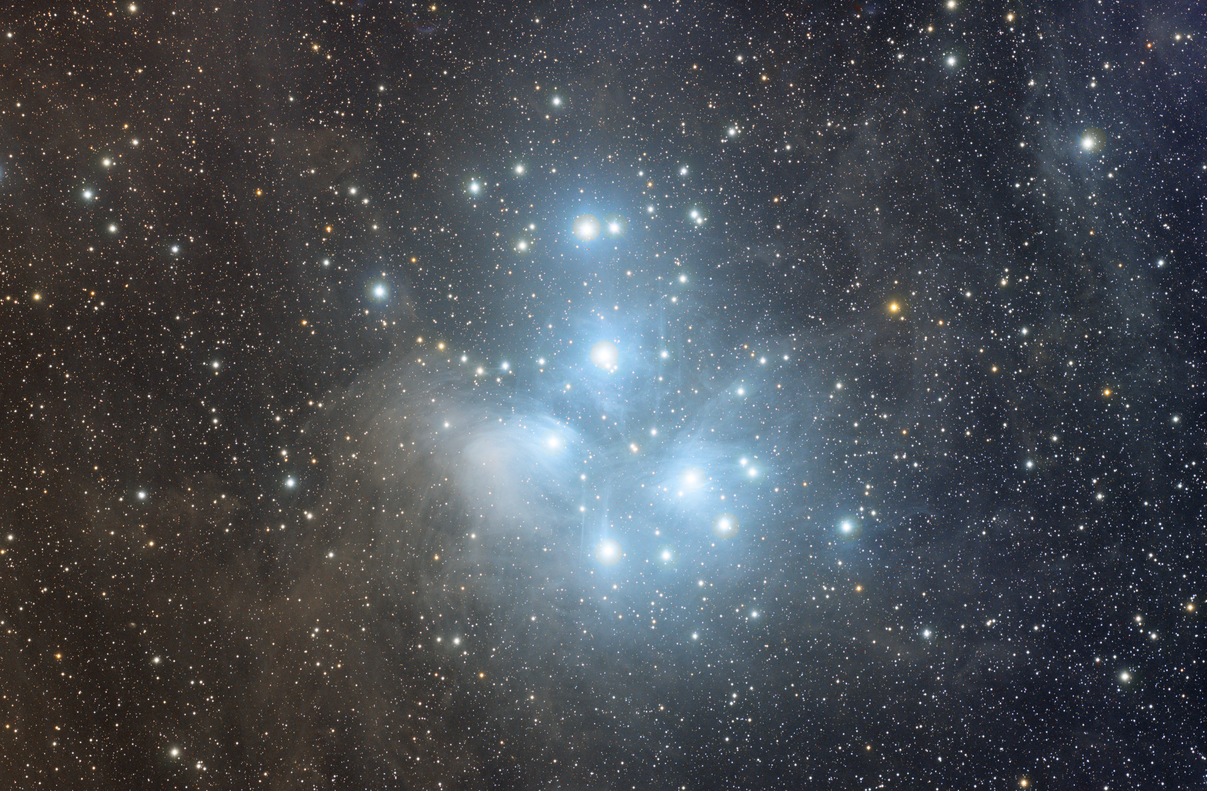
Chris Todd
Notes:
My Pleiades shot – iTelescope.net T14 – Takahashi FSQ106, STL-11000. 5 hours; 24 x 5 min luminance, 24 x 5 min blue, 6 x 5 min red, 6 x 5 min green, relatively minimal processing (no deconvolution, I didn’t use masks when stretching, no LHE, no ATWT, no noise reduction). Total cost of this image was 342 points, or about $300-325 (AUD to USD exchange rate is favorable right now).

Slide 61
This image did *NOT* cost me:
Takahashi FSQ-106: ~$5,000
SBIG STL-11000M: ~$9,000
Astrodon filters: ~$1,800
Paramount GT-1100S ~$8,000?
Autoguider, software, etc: ~$5,000?
~$30,000 total, not counting location, dome, etc.
Notes:
Ask whether anyone knows of any others.

Slide 62
iTelescope.net
Live Demo

Slide 63
Thank You!
Next month’s meeting is on Thursday,
December 19th, 2013
7:30 PM
Meeting theme:
Member’s Potluck!
Sign up on the forum to bring a dish, and come to the meeting hungry!

